Slide 1

Vegetable Oil Outlook
October 17, 2019

Slide 2
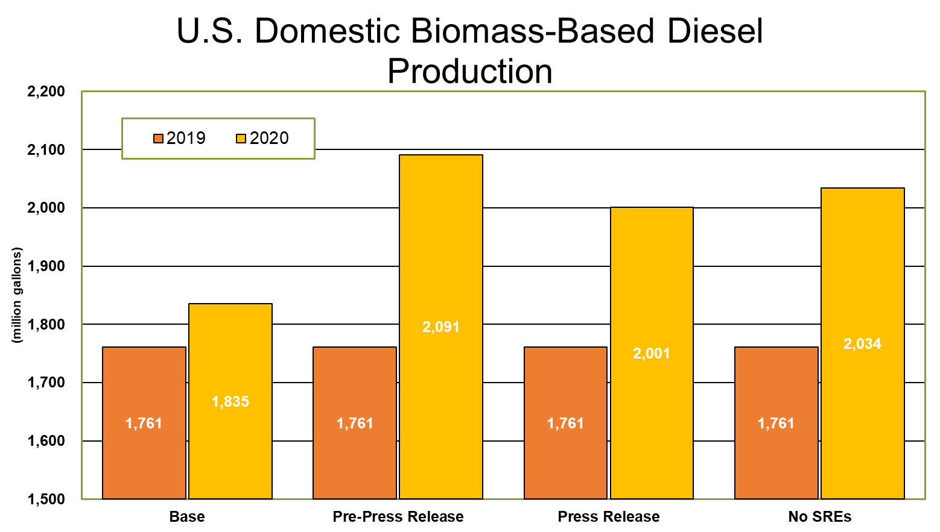
U.S. BIOFUEL POLICY
In October President Trump released his long-awaited and much anticipated program to boost domestic biofuel use.
Pre-release expectations for components of the plan included supplemental RVOs, reductions in SREs and offsets for gallons exempted in prior years.
The press release was short on details, but interviews with Secretary of Agriculture Perdue made it clear the plan was focused on ethanol usage.
The plan reportedly includes an offset for projected SREs, but more will be known when the details are published in the Federal Register.

Slide 3
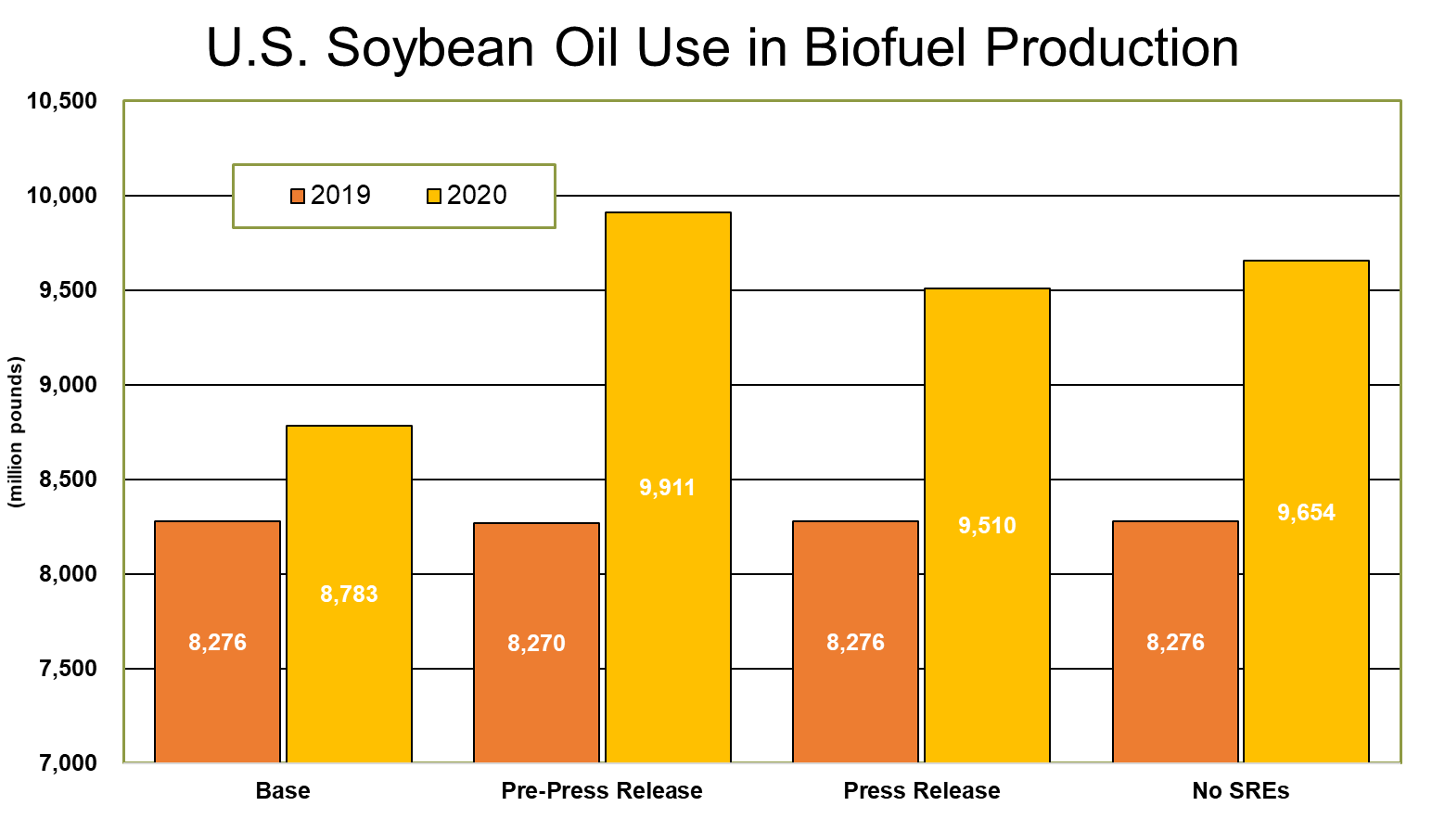
U.S. BIOFUEL POLICY
The impact of less than optimal management of expectations has been disappointment from many in the biofuel industry.
There is also some fear that President Trump may have become frustrated by the difficultly of finding a solution that keeps farm and energy interests happy and may pivot to trade negotiations with the Chinese to provide support for the agricultural industry.

Slide 4
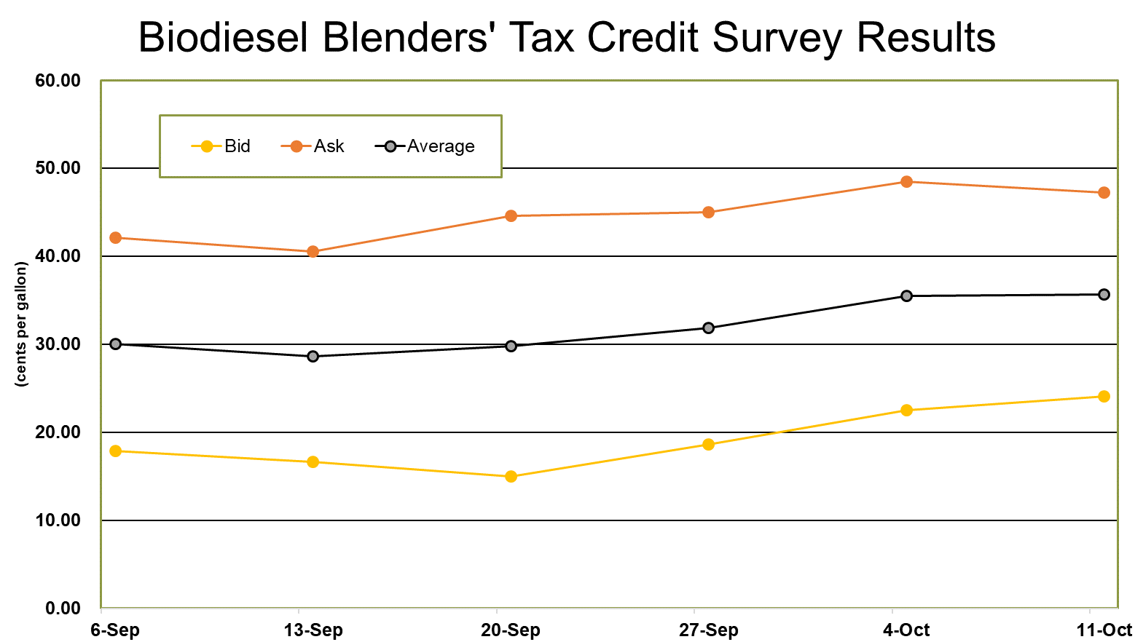
U.S. BIOFUEL POLICY
Staff members of the House Ways and Means and Senate Finance Committees have been negotiating a bill for the “tax extenders” package that could be attached to the omnibus spending bill that must be passed when the continuing resolution expires.
Increased optimism about the restoration of the BTC is driving bids higher.
The decline in offers may be more of an indication of risk tolerances than an opinion about the probability of the reinstatement of the BTC.

Slide 5
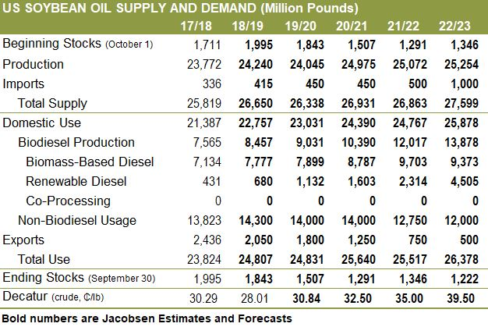
U.S. BIOFUELS POLICY
The Jacobsen is projecting soybean oil demand for biomass-based diesel production will be relatively flat for 2019/20, but growth in renewable diesel production raises demand from the biofuel industry.
Biofuel demand is expected to start crowding out other sectors as soon as 2020/21.
A reduction in exports can provide the supply for biofuel for a while, but eventually crush may be driven by soybean oil.
Even if federal renewable fuel policy remains uncertain, state-level efforts in the Corn-Belt could replace the Renewable Fuel Standard as the driving force behind biodiesel demand.

Slide 6
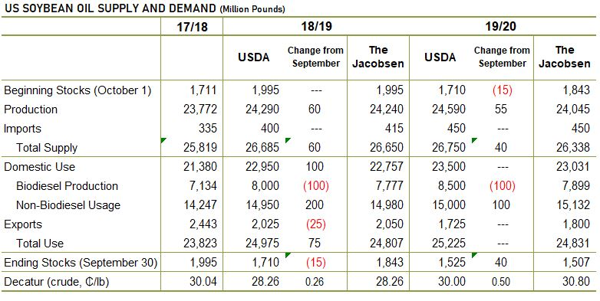
U.S. BALANCE SHEET
The Jacobsen and USDA have similar 2019/20 ending stocks but get there in slightly different ways.
The Jacobsen’s crush forecast is 45 million bushels below USDA’s prediction, which reduces production by more than 500 million pounds.
The Jacobsen’s biomass-based diesel use forecast is substantially below USDA’s projection, but could be raised substantially if BTC is reinstated.
Despite similar ending stocks projections, The Jacobsen is predicting soybean oil prices almost one cent per pound higher than USDA and believes there is more upside price risk than downside.

Slide 7
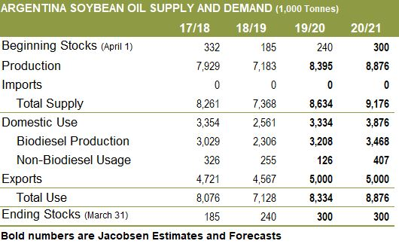
ARGENTINA
The Jacobsen is projecting growth in biodiesel production. However, change in the status of U.S. Commerce Department’s review of counter-vailing duties could limit growth.
If biodiesel use is below The Jacobsen’s forecast, the additional supply is likely to be exported.
Weather has been dry and hot to start the growing season, but recent changes have improved soil moisture levels in some areas.

Slide 8
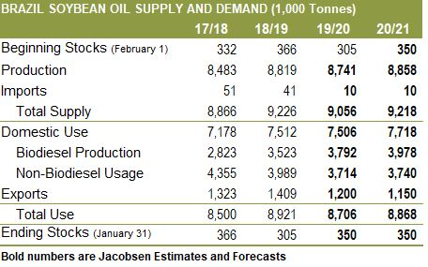
BRAZIL
Growing domestic biodiesel use is expected to drive exports lower.
Brazilian soybean production is likely to remain robust in the coming years, which could provide additional room for crush.
U.S./China trade deal expected to slightly reduce Brazilian shipments to China, which could allow for larger crush, but crop size will determine availability.

Slide 9
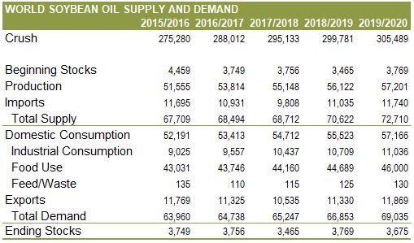
WORLD
Growth in world soybean crush is expected to continue slower growth rate in 2019/20, which could limit supply as demand from trade grows.
USDA is projecting strong exports, but The Jacobsen is predicting a decline in shipments from major exporting countries.
Industrial consumption growth is slowing, but growth in food use is accelerating.

Slide 10
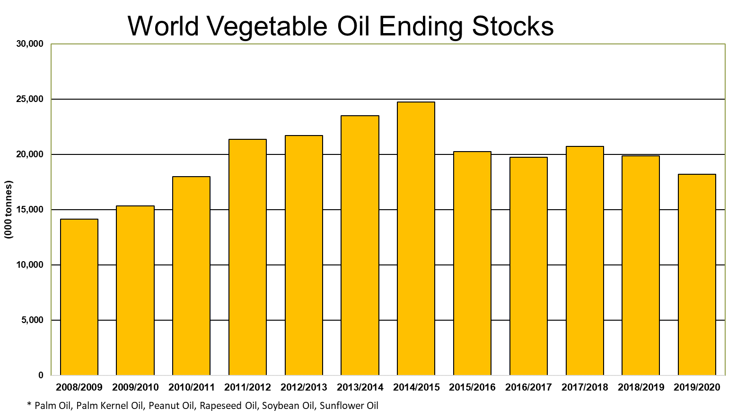
WORLD VEGETABLE OILS
Total vegetable oil inventories are forecast to decline for the third consecutive year and are well down from 2014/15 peak.
Growth in food use is driving the tightening world stocks.
Growth in industrial use, including biofuel, is growing, but much more slowly than in recent years.

Slide 11
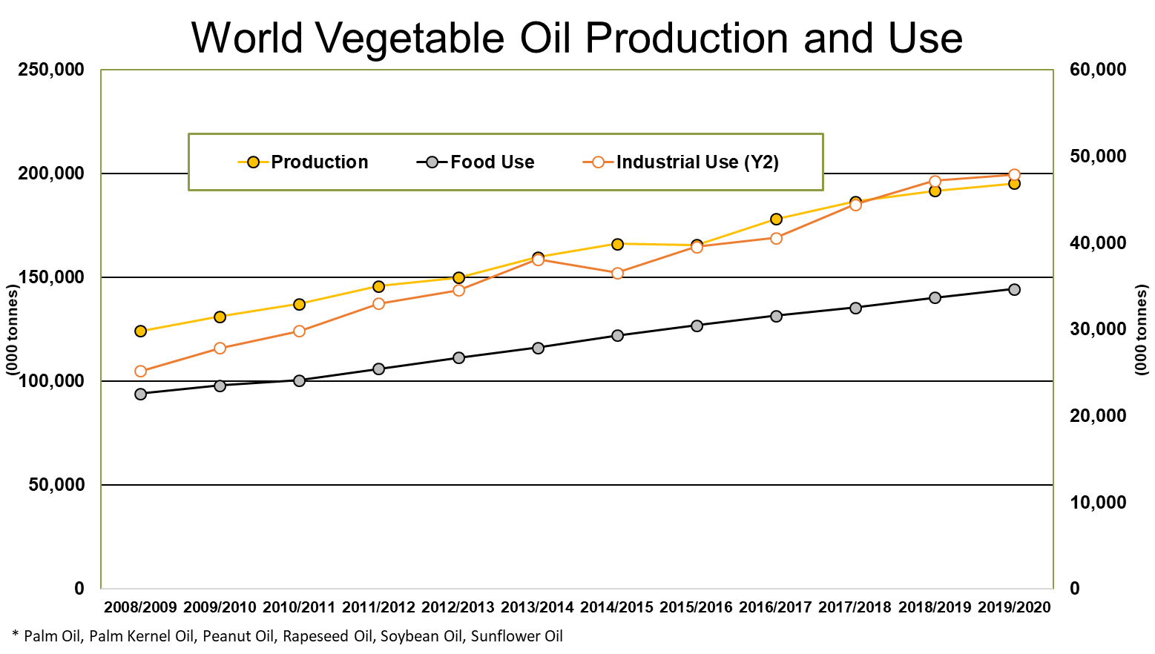
WORLD VEGETABLE OILS
Growth in food use is driving the tightening world stocks.
Growth in industrial use, including biofuel, is growing, but much more slowly than in recent years.
Despite the slowdown in industrial use it has grown about two percent faster over the last 10 years than production and will increasingly weigh on inventory levels.

Slide 12
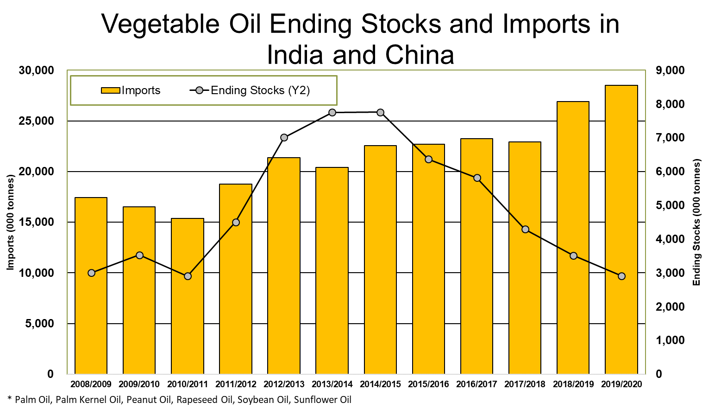
WORLD VEGETABLE OILS
Chinese imports were mostly flat for the last eight years but are expected to grow sharply over the next two years. Ultimately whether this is where Chinese imports start to accelerate will depend on how quickly they recover from ASF.
Falling stocks drove Chinese vegetable oil futures almost 15 percent higher from late July to early August.
Indian production is flat over the last 10 years just below six million tonnes but domestic consumption, mostly food usage, has almost doubled to 23 million.

Slide 13
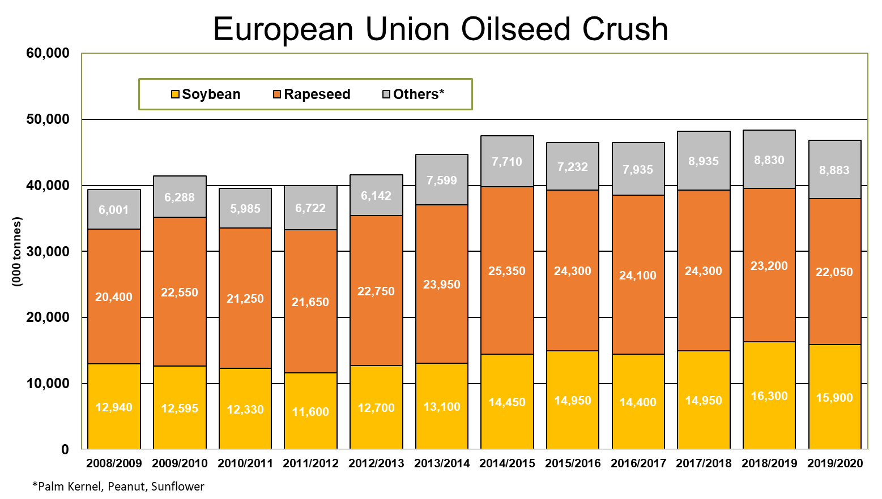
WORLD VEGETABLE OILS
European rapeseed production has declined by about 23 percent over the last two years. Production in 2019 was the lowest since 2006.
European Union likely to increase imports of oilseeds to offset rapeseed crop losses.
European Union oilseed crush is forecast to fall to the lowest level in the last three years following summer drought.
Despite the decline in crush, vegetable oil imports are not expected to increase substantially due to decreasing industrial use.

Slide 14
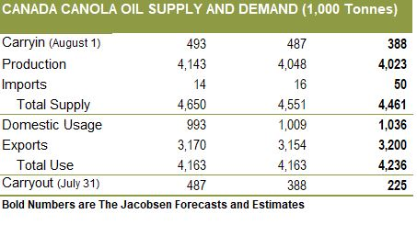
WORLD VEGETABLE OILS
Canadian canola production is expected to decline by at least five percent due to harvest delays due to recent weather.
The bulk of the decline will reduce canola exports, which are forecast to fall to the lowest level since 2014/15.
Canadian crush is expected to remain steady, even if the crop is smaller than expected.
Canola oil exports are also predicted to remain relatively unchanged, but growing biodiesel production is forecast to draw stocks down to the lowest level since 2013/14.

Slide 15
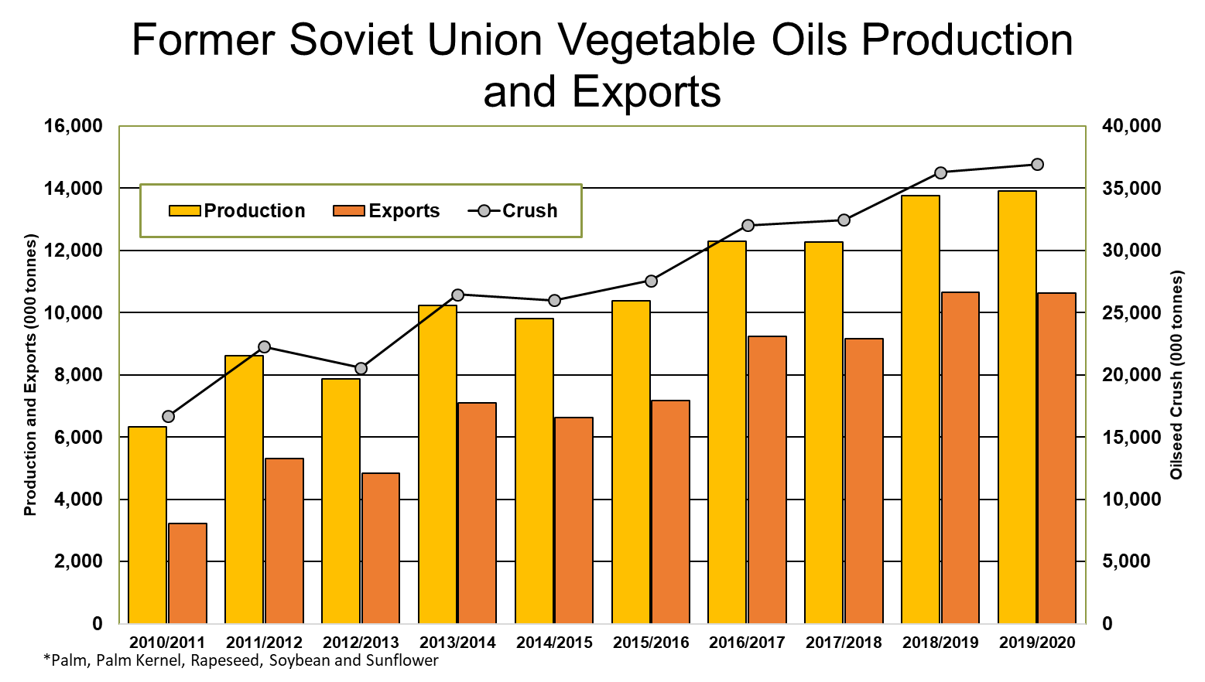
WORLD VEGETABLE OILS
Rapeseed and sunflower seed production in the Black Sea region will provide some offset to the bullish world fundamentals.

Slide 16
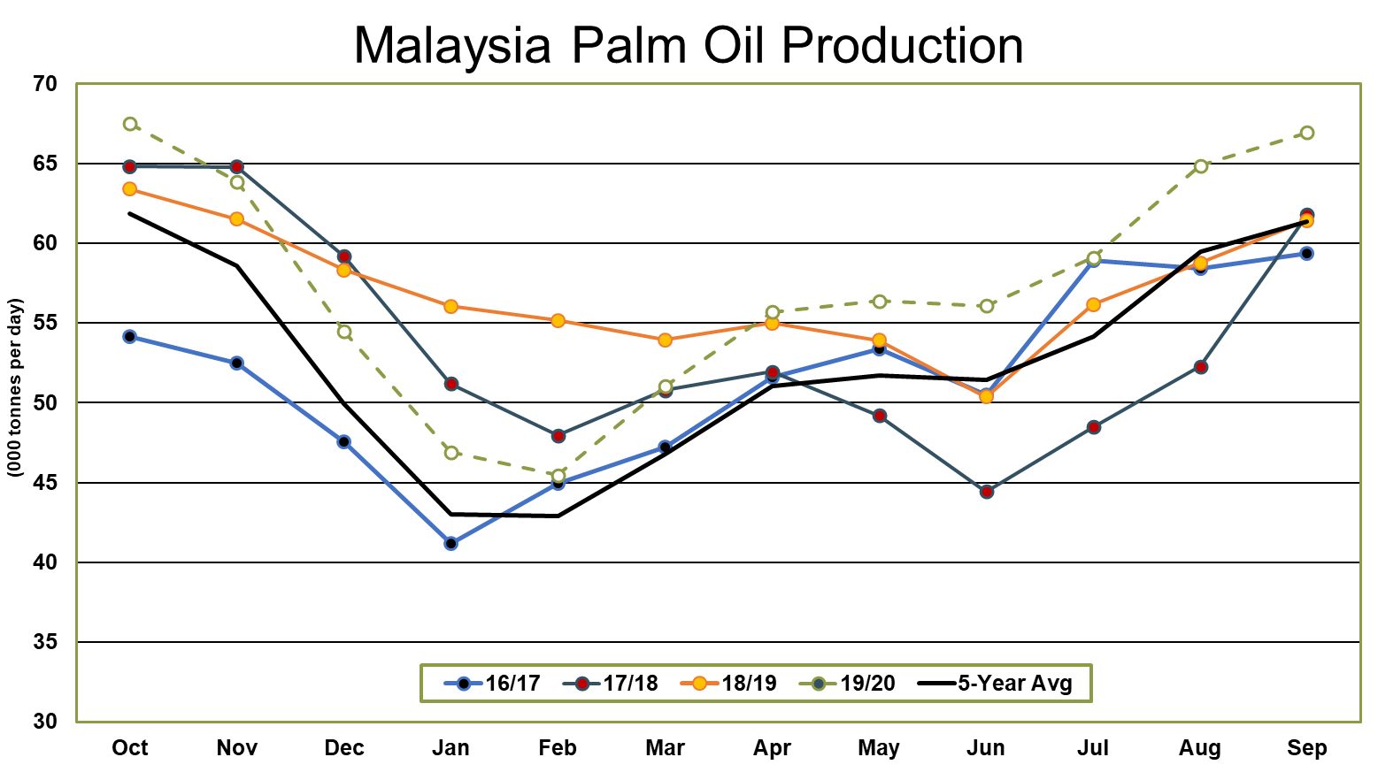
WORLD VEGETABLE OILS
Malaysian palm oil production is forecast to remain stable in 2019/20 as a decline in yield offsets a small increase in mature area.
Dryness earlier in the year and in recent months may reduce yields beyond The Jacobsen’s forecast. However, if rainfall returns to normal levels, yields could be substantially above The Jacobsen’s expectation.

Slide 17
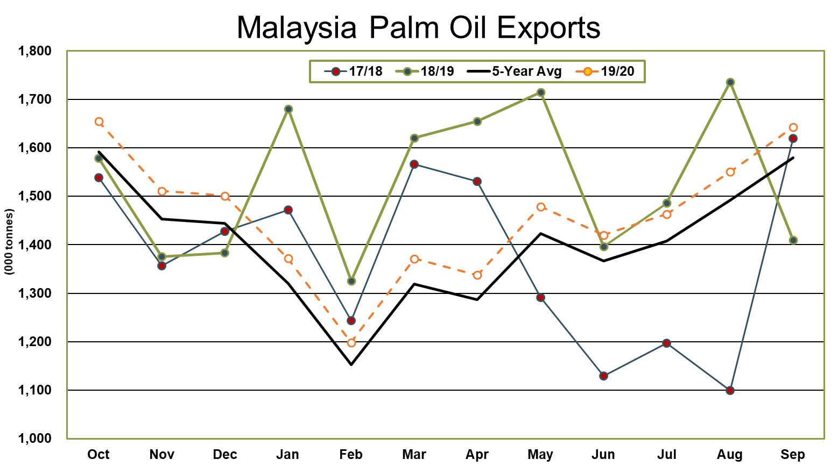
WORLD VEGETABLE OILS
Palm oil exports have been volatile as the Indian government has reduced and raised tariff rates on Malaysian palm oil imports.
Current tensions have cut off exports to India, but recent progress in trade negotiations could break the impasse.
Malaysian shipments to China have increased dramatically over the last year and could offset any decline in shipments to India.

Slide 18
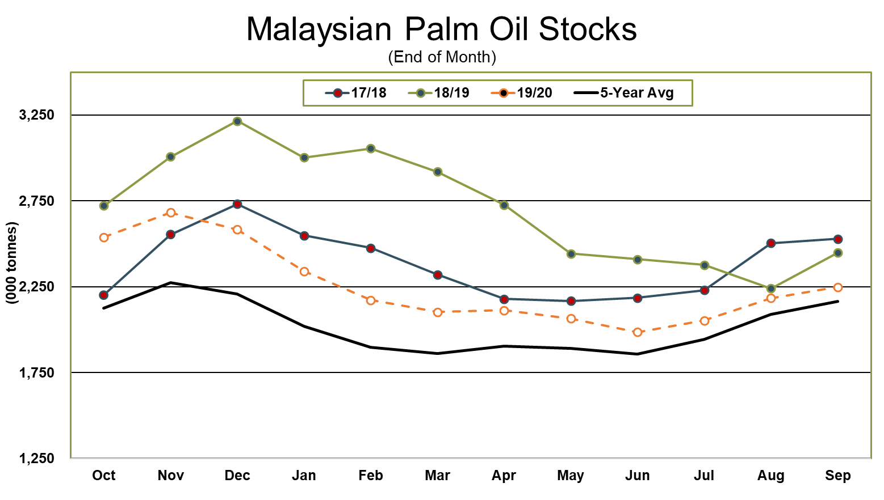
WORLD VEGETABLE OILS
Stocks are forecast to fall to a three-year low and could drop below two million tonnes in early summer.
European Union’s stance on palm oil use in biofuel production remains a substantial risk to The Jacobsen’s stocks outlook.
Palm oil shipments from Indonesia and Malaysia will need to continue to grow in the coming years to meet the growing demand from India and potentially China.

Slide 19
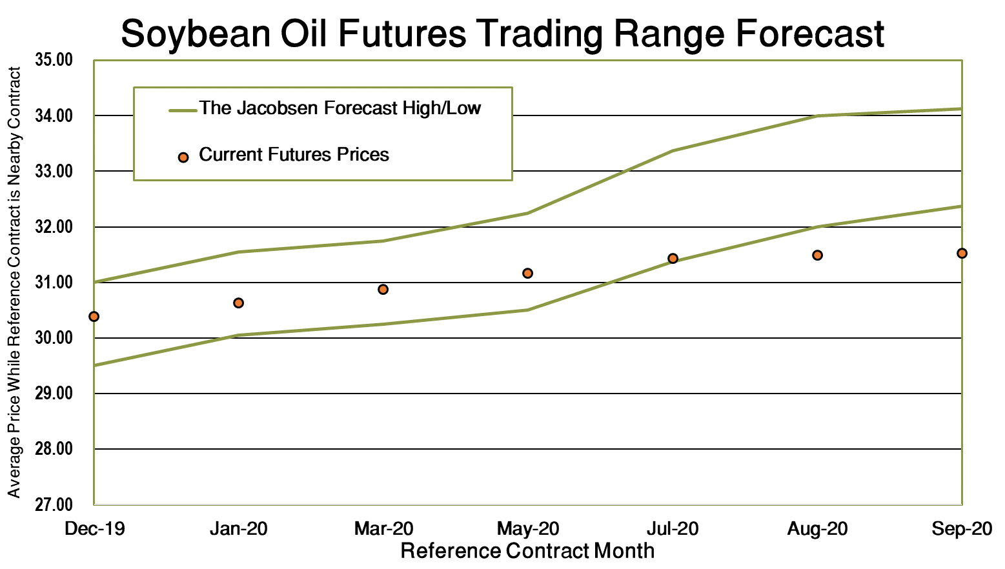
SOYBEAN OIL FORECAST
Soybean oil futures are forecast to remain well supported even if biomass-based diesel production continues to slow.
Vegetable oil shortages in China and growing demand in India could provide additional exports, but soybean oil will need to compete with palm oil.
If BTC is restored, there will be additional upside price risk.
Significant renewable diesel capacity coming online in 2021 - 2023 will provide longer term support and, in the most bullish case, could ultimately drive oilshare above 50 percent.

Slide 20
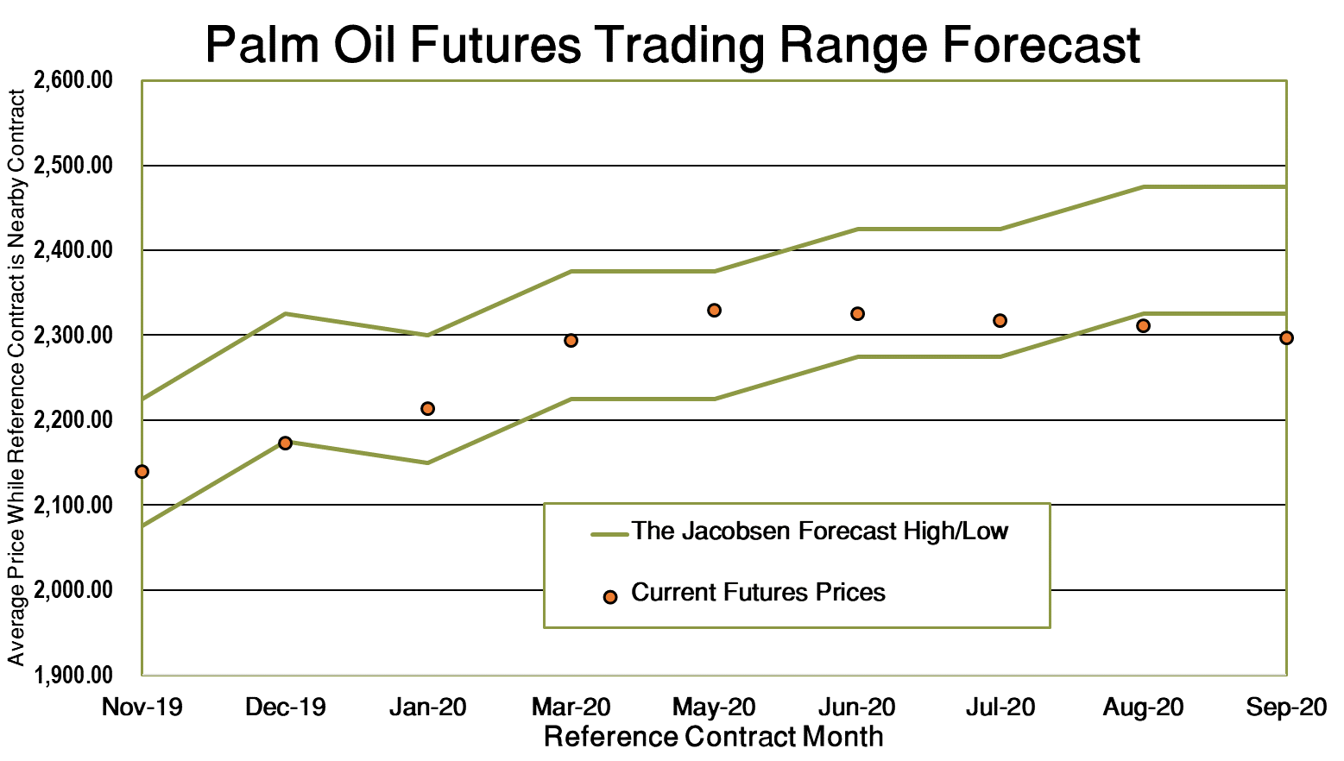
PALM OIL FORECAST
Palm oil is expected to benefit from rising world vegetable oil prices, but there are risks that could drive the spread between palm oil and soybean oil to the upper end of the historical range.
Weather conditions could provide additional support for prices if drier-than-normal conditions continue into next year.

